Slide 2
How to read the Daily COVID-19 Symptom Tracker
What do the colors mean and when should Weigel be called?

Slide 3
Where can students access the tracker?
www.weigelsp.buffalostate.edu

Slide 4
Entering the Classroom
Please ask students to show you their tracker information for that day upon entering the classroom.
Check for the student’s name in the top right corner.
Check the center dot color and/or messaging (Positive/Red, Negative/Green, Pending/Yellow, Documented Exposure/Orange, Expired/Grey, No Data/Black as well as Date (date should be the calendar date of that specific class meeting).

Slide 5
Daily COVID-19 Symptom Tracker for Students (Look for the GREEN dot)
Check for student name
Green = you may come to class. Please continue to wear a mask covering your nose and mouth, practice social distancing and wash hands frequently.
Check for color. health status and date!

Slide 6
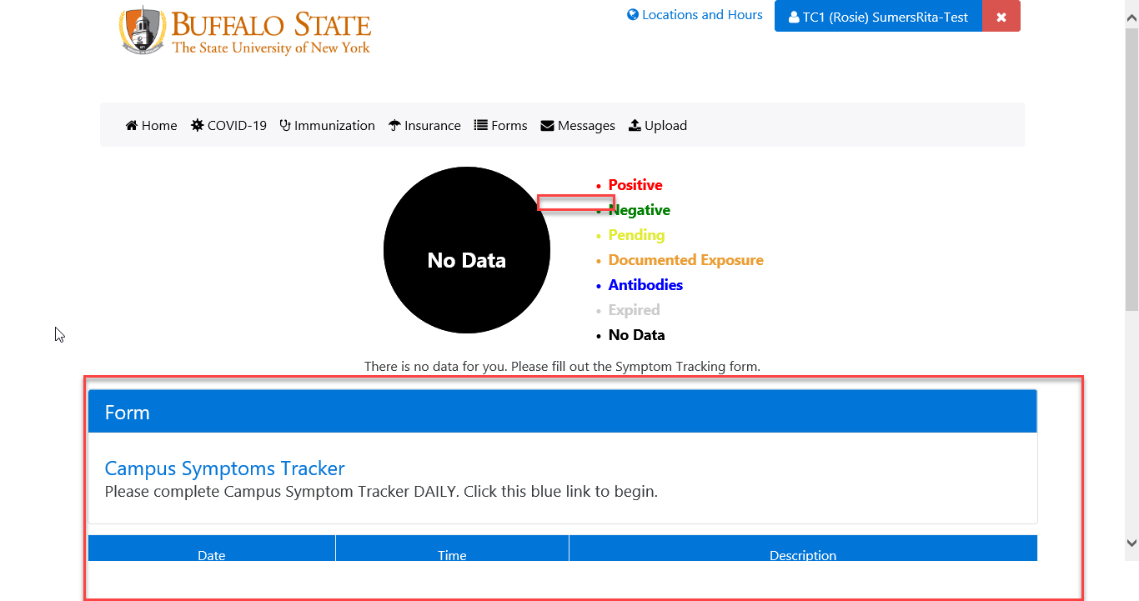
BLACK DOT
A black dot means the student has yet to use the tracker and should immediately answer the tracker questions.

Slide 7
RED DOT
A red dot = this student has indicated that they have symptoms, exposure or positive results. This student should NOT be in class. If they live on campus, they should not leave their room. The student should contact Weigel.

Slide 8
ORANGE DOT
An orange dot indicates that the student has been exposed to COVID-19. They must quarantine/isolate. If this student is in your presence -You (faculty/staff) must now alert your supervisor and your physician.

Slide 9
Students should only be permitted to sit in class when their tracker displays a green dot for the day of class (be sure to verify their name and the date also).
If any other color (or health status is listed) than green is displayed on the tracker, do not let the student in class. Please tell the student to return to there residence and have the student call Weigel Health at
716-878-6701.

Slide 10
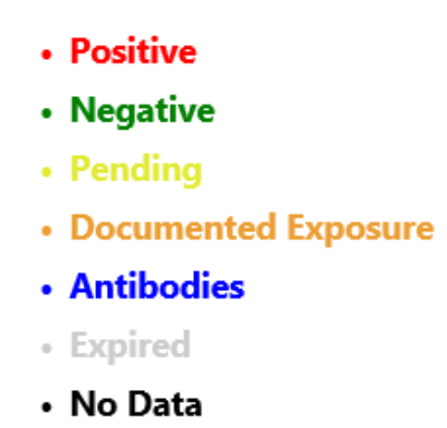
LEGEND Review
RED – Do not allow student in class. Have the student contact Weigel immediately.
GREEN- Cleared to be in class.
YELLOW- Tell the student to call Weigel.
ORANGE- Not eligible to sit in class, Student should quarantine immediately – Call Weigel.
BLUE- We do not do Antibody testing on campus – Call Weigel.
GREY- Info not in system- redo tracker for the day.
BLACK- Student has yet to complete the tracker. Complete tracker.

Slide 11
Questions?
Call the Dean of Students:
716-878-4618
Call Weigel Health:
716-878-6711

